Slide 1
Chapter 13: Query Optimization

Slide 2
Chapter 13: Query Optimization
Introduction
Transformation of Relational Expressions
Catalog Information for Cost Estimation
Statistical Information for Cost Estimation
Cost-based optimization
Dynamic Programming for Choosing Evaluation Plans
Materialized views

Slide 3
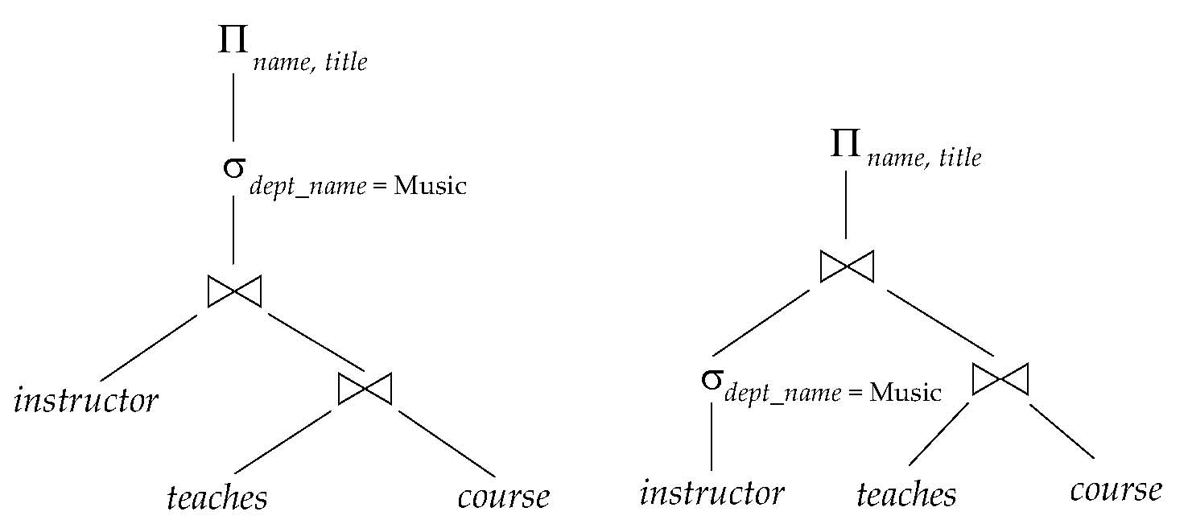
Introduction
Alternative ways of evaluating a given query
Equivalent expressions
Different algorithms for each operation

Slide 4
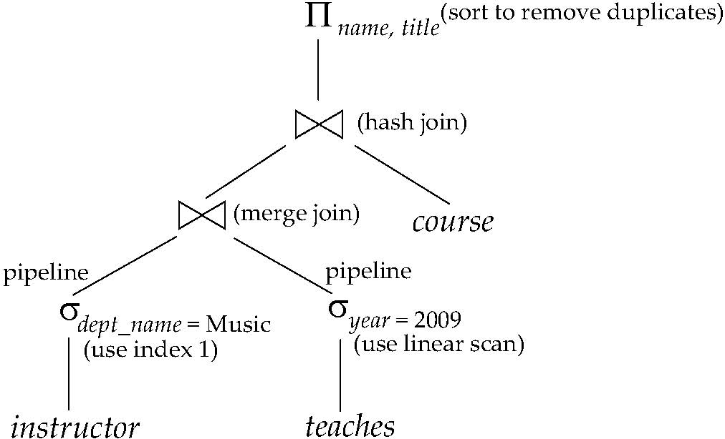
Introduction (Cont.)
An evaluation plan defines exactly what algorithm is used for each operation, and how the execution of the operations is coordinated.
Find out how to view query execution plans on your favorite database

Slide 5
Introduction (Cont.)
Cost difference between evaluation plans for a query can be enormous
E.g. seconds vs. days in some cases
Steps in cost-based query optimization
Generate logically equivalent expressions using equivalence rules
Annotate resultant expressions to get alternative query plans
Choose the cheapest plan based on estimated cost
Estimation of plan cost based on:
Statistical information about relations. Examples:
number of tuples, number of distinct values for an attribute
Statistics estimation for intermediate results
to compute cost of complex expressions
Cost formulae for algorithms, computed using statistics

Slide 6
Generating Equivalent Expressions

Slide 7
Transformation of Relational Expressions
Two relational algebra expressions are said to be equivalent if the two expressions generate the same set of tuples on every legal database instance
Note: order of tuples is irrelevant
we don’t care if they generate different results on databases that violate integrity constraints
In SQL, inputs and outputs are multisets of tuples
Two expressions in the multiset version of the relational algebra are said to be equivalent if the two expressions generate the same multiset of tuples on every legal database instance.
An equivalence rule says that expressions of two forms are equivalent
Can replace expression of first form by second, or vice versa

Slide 8
Equivalence Rules
1. Conjunctive selection operations can be deconstructed into a sequence of individual selections.
2. Selection operations are commutative.
Only the last in a sequence of projection operations is needed, the others can be omitted.
Selections can be combined with Cartesian products and theta joins.
σ_{θ}(E₁ X E₂) = E₁ _{θ} E₂
σ_{θ1}(E₁ _{θ2} E₂) = E₁ _{θ1∧ θ2} E₂

Slide 9
Equivalence Rules (Cont.)
5. Theta-join operations (and natural joins) are commutative. E_{1 θ} E₂ = E₂ _{θ} E₁
6. (a) Natural join operations are associative:
(E₁ E₂) E₃ = E₁ (E₂ E₃) (b) Theta joins are associative in the following manner: (E_{1 θ1} E₂) _{θ2∧ θ3} E₃ = E_{1 θ1∧ θ3} (E₂ _{θ2} E₃) where θ₂ involves attributes from only E₂ and E₃.

Slide 10
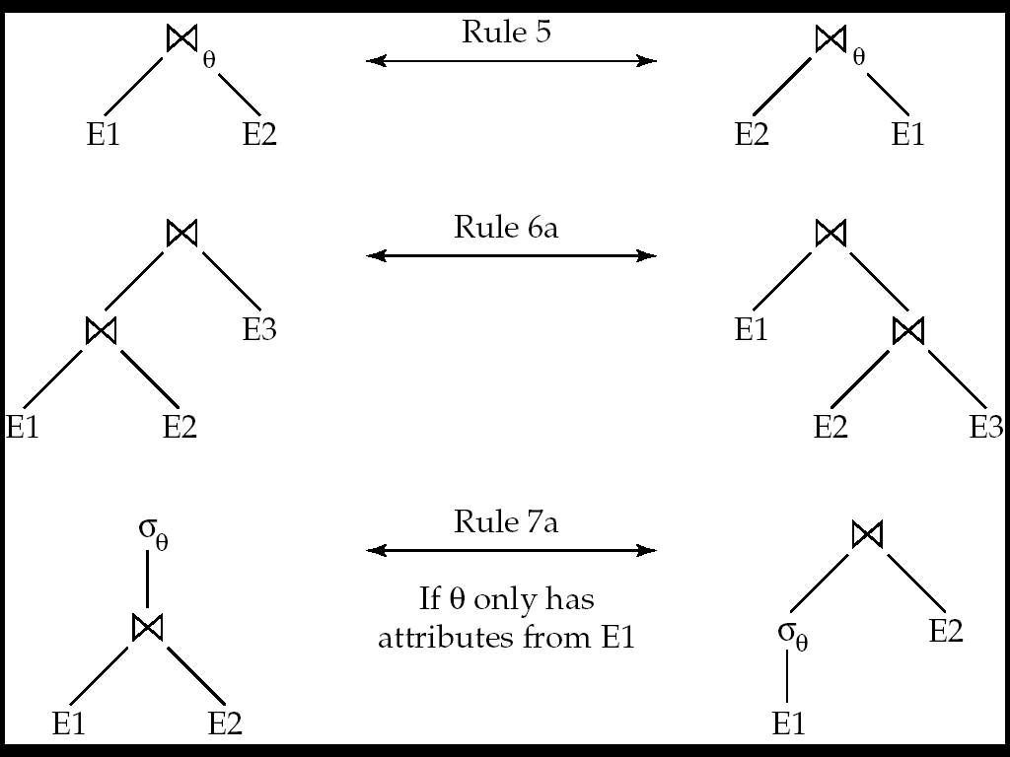
Pictorial Depiction of Equivalence Rules

Slide 11
Equivalence Rules (Cont.)
7. The selection operation distributes over the theta join operation under the following two conditions: (a) When all the attributes in θ₀ involve only the attributes of one of the expressions (E₁) being joined. σ_{θ0}(E₁ _{θ} E₂) = (σ_{θ0}(E₁)) _{θ} E₂
(b) When θ ₁ involves only the attributes of E₁ and θ₂ involves only the attributes of E₂.
σ_{θ1}∧_{θ2} (E₁ _{θ} E₂) = (σ_{θ1}(E₁)) _{θ} (σ_{θ2} (E₂))

Slide 12
Equivalence Rules (Cont.)
8. The projection operation distributes over the theta join operation as follows:
(a) if θ involves only attributes from L₁ ∪ L₂:
(b) Consider a join E_{1 θ} E₂.
Let L₁ and L₂ be sets of attributes from E₁ and E₂, respectively.
Let L₃ be attributes of E₁ that are involved in join condition θ, but are not in L₁ ∪ L₂, and
let L₄ be attributes of E₂ that are involved in join condition θ, but are not in L₁ ∪ L₂.
∏
(
E
E
)
=
(
∏
(
E
))
(
∏
(
E
))
L
1
∪
L
2
1
θ
2
L
1
1
θ
L
2
2
∏
(
E
E
)
=
∏
((
∏
(
E
))
(
∏
(
E
)))
L
1
∪
L
2
1
θ
2
L
1
∪
L
2
L
1
∪
L
3
1
θ
L
2
∪
L
4
2

Slide 13
Equivalence Rules (Cont.)
The set operations union and intersection are commutative E₁ ∪ E₂ = E₂ ∪ E₁ E₁ ∩ E₂ = E₂ ∩ E₁
(set difference is not commutative).
Set union and intersection are associative.
(E₁ ∪ E₂) ∪ E₃ = E₁ ∪ (E₂ ∪ E₃) (E₁ ∩ E₂) ∩ E₃ = E₁ ∩ (E₂ ∩ E₃)
The selection operation distributes over ∪, ∩ and –. σ_{θ} (E₁ – E₂) = σ_{θ} (E₁) – σ_{θ}(E₂) and similarly for ∪ and ∩ in place of – Also: σ_{θ} (E₁ – E₂) = σ_{θ}(E₁) – E₂ and similarly for ∩ in place of –, but not for ∪
12. The projection operation distributes over union
Π_{L}(E₁ ∪ E₂) = (Π_{L}(E₁)) ∪ (Π_{L}(E₂))

Slide 14
Transformation Example: Pushing Selections
Query: Find the names of all instructors in the Music department, along with the titles of the courses that they teach
Π_{name, title}(σ_{dept_name= “Music”} (instructor (teaches Π_{course_id, title} (course))))
Transformation using rule 7a.
Π_{name, title}((σ_{dept_name= “Music”}(instructor)) (teaches Π_{course_id, title} (course)))
Performing the selection as early as possible reduces the size of the relation to be joined.

Slide 15
Example with Multiple Transformations
Query: Find the names of all instructors in the Music department who have taught a course in 2009, along with the titles of the courses that they taught
Π_{name, title}(σ_{dept_name= “Music”∧year = 2009} (instructor (teaches Π_{course_id, title} (course))))
Transformation using join associatively (Rule 6a):
Π_{name, title}(σ_{dept_name= “Music”∧gear = 2009} ((instructor teaches) Π_{course_id, title} (course)))
Second form provides an opportunity to apply the “perform selections early” rule, resulting in the subexpression
σ_{dept_name = “Music”} (instructor) σ _{year = 2009} (teaches)

Slide 16
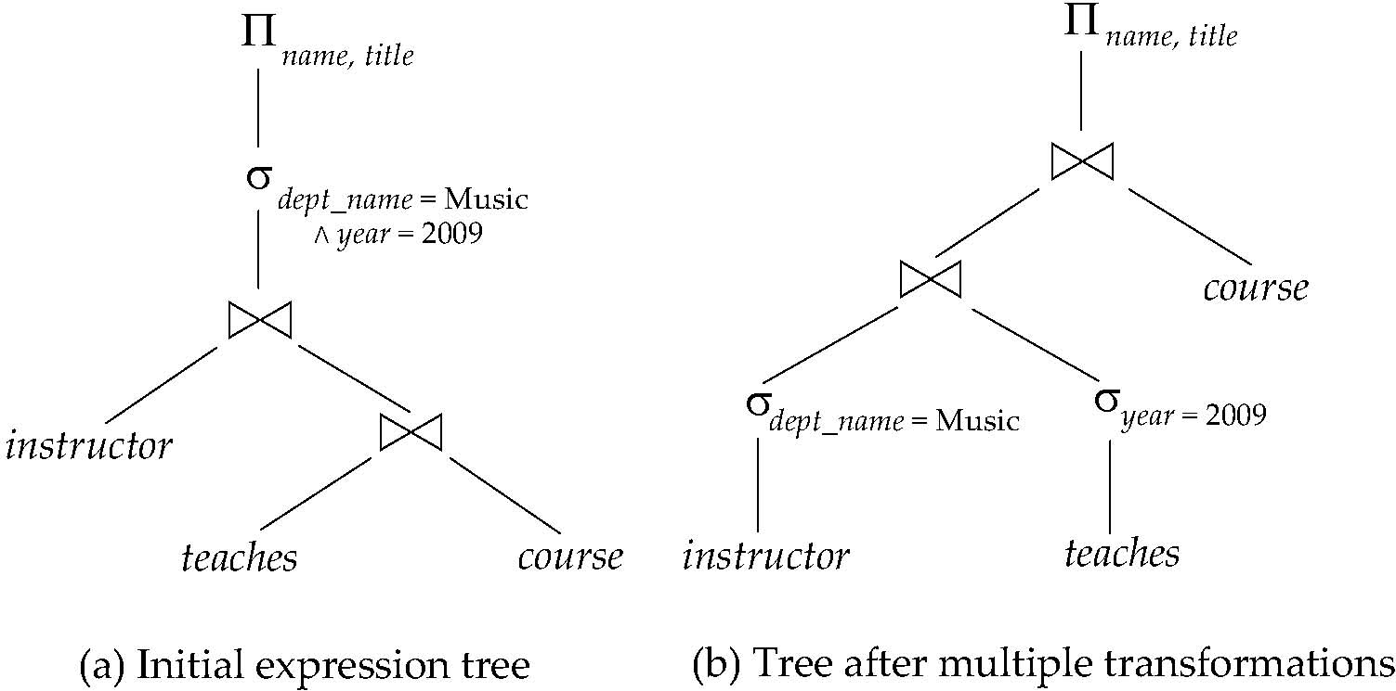
Multiple Transformations (Cont.)

Slide 17
Transformation Example: Pushing Projections
Consider: Π_{name, title}(σ_{dept_name= “Music”} (instructor) teaches) Π_{course_id, title} (course))))
When we compute
(σ_{dept_name = “Music”} (instructor teaches)
we obtain a relation whose schema is: (ID, name, dept_name, salary, course_id, sec_id, semester, year)
Push projections using equivalence rules 8a and 8b; eliminate unneeded attributes from intermediate results to get: Π_{name, title}(Π_{name, course_id} ( σ_{dept_name= “Music”} (instructor) teaches)) Π_{course_id, title} (course))))
Performing the projection as early as possible reduces the size of the relation to be joined.

Slide 18
Join Ordering Example
For all relations r_{1,} r_{2,} and r₃,
(r₁ r₂) r₃ = r₁ (r₂ r₃ )
(Join Associativity)
If r₂ r₃ is quite large and r₁ r₂ is small, we choose
(r₁ r₂) r₃
so that we compute and store a smaller temporary relation.

Slide 19
Join Ordering Example (Cont.)
Consider the expression
Π_{name, title}(σ_{dept_name= “Music”} (instructor) teaches) Π_{course_id, title} (course))))
Could compute teaches Π_{course_id, title} (course) first, and join result with σ_{dept_name= “Music”} (instructor) but the result of the first join is likely to be a large relation.
Only a small fraction of the university’s instructors are likely to be from the Music department
it is better to compute
σ_{dept_name= “Music”} (instructor) teaches
first.

Slide 20
Statistics for Cost Estimation

Slide 21
Statistical Information for Cost Estimation
n_{r}: number of tuples in a relation r.
b_{r}: number of blocks containing tuples of r.
l_{r}: size of a tuple of r.
f_{r}: blocking factor of r — i.e., the number of tuples of r that fit into one block.
V(A, r): number of distinct values that appear in r for attribute A; same as the size of ∏_{A}(r).
If tuples of r are stored together physically in a file, then:

Slide 22
Histograms
Histogram on attribute age of relation person
Equi-width histograms
Equi-depth histograms

Slide 23
Selection Size Estimation
σ_{A=v}(r)
n_{r} / V(A,r) : number of records that will satisfy the selection
Equality condition on a key attribute: size estimate = 1
σ_{A≤V}(r) (case of σ_{A ≥ V}(r) is symmetric)
Let c denote the estimated number of tuples satisfying the condition.
If min(A,r) and max(A,r) are available in catalog
c = 0 if v < min(A,r)
c =
If histograms available, can refine above estimate
In absence of statistical information c is assumed to be n_{r} / 2.

Slide 24
Size Estimation of Complex Selections
The selectivity of a condition θ_{i} is the probability that a tuple in the relation r satisfies θ_{i} .
If s_{i} is the number of satisfying tuples in r, the selectivity of θ_{i} is given by s_{i} /n_{r}.
Conjunction: σ_{θ1∧ θ2∧. . . ∧ θn} (r). Assuming indepdence, estimate of tuples in the result is:
Disjunction:σ_{θ1∨} _{θ2 ∨. . . ∨} _{θn} (r). Estimated number of tuples:
Negation: σ_{¬θ}(r). Estimated number of tuples: n_{r} – size(σ_{θ}(r))

Slide 25
Join Operation: Running Example
Running example: student takes
Catalog information for join examples:
n_{student} = 5,000. f_{student} = 50, which implies that b_{student} =5000/50 = 100.
n_{takes} = 10000.f_{takes} = 25, which implies that b_{takes} = 10000/25 = 400.
V(ID, takes) = 2500, which implies that on average, each student who has taken a course has taken 4 courses.
Attribute ID in takes is a foreign key referencing student.
V(ID, student) = 5000 (primary key!)

Slide 26
Estimation of the Size of Joins
The Cartesian product r x s contains n_{r} .n_{s} tuples; each tuple occupies s_{r} + s_{s} bytes.
If R ∩ S = ∅, then r s is the same as r x s.
If R ∩ S is a key for R, then a tuple of s will join with at most one tuple from r
therefore, the number of tuples in r s is no greater than the number of tuples in s.
If R ∩ S in S is a foreign key in S referencing R, then the number of tuples in r s is exactly the same as the number of tuples in s.
The case for R ∩ S being a foreign key referencing S is symmetric.
In the example query student takes, ID in takes is a foreign key referencing student
hence, the result has exactly n_{takes} tuples, which is 10000

Slide 27
Estimation of the Size of Joins (Cont.)
If R ∩ S = {A} is not a key for R or S. If we assume that every tuple t in R produces tuples in R S, the number of tuples in R S is estimated to be: If the reverse is true, the estimate obtained will be: The lower of these two estimates is probably the more accurate one.
Can improve on above if histograms are available
Use formula similar to above, for each cell of histograms on the two relations

Slide 28
Estimation of the Size of Joins (Cont.)
Compute the size estimates for student takes without using information about foreign keys:
V(ID, takes) = 2500, and V(ID, student) = 5000
The two estimates are 5000 * 10000/2500 = 20,000 and 5000 * 10000/5000 = 10000
We choose the lower estimate, which in this case, is the same as our earlier computation using foreign keys.

Slide 29
Size Estimation for Other Operations
Projection: estimated size of ∏_{A}(r) = V(A,r)
Aggregation : estimated size of _{A}g_{F}(r) = V(A,r)
Set operations
For unions/intersections of selections on the same relation: rewrite and use size estimate for selections
E.g. σ_{θ1} (r) ∪ σ_{θ2} (r) can be rewritten as σ_{θ1 ˅ θ2} (r)
For operations on different relations:
estimated size of r ∪ s = size of r + size of s.
estimated size of r ∩ s = minimum size of r and size of s.
estimated size of r – s = r.
All the three estimates may be quite inaccurate, but provide upper bounds on the sizes.

Slide 30
Size Estimation (Cont.)
Outer join:
Estimated size of r s = size of r s + size of r
Case of right outer join is symmetric
Estimated size of r s = size of r s + size of r + size of s

Slide 31
Estimation of Number of Distinct Values
Selections: σ_{θ} (r)
If θ forces A to take a specified value: V(A,σ_{θ} (r)) = 1.
e.g., A = 3
If θ forces A to take on one of a specified set of values: V(A,σ_{θ} (r)) = number of specified values.
(e.g., (A = 1 V A = 3 V A = 4 )),
If the selection condition θ is of the form A op r estimated V(A,σ_{θ} (r)) = V(A.r) * s
where s is the selectivity of the selection.
In all the other cases: use approximate estimate of min(V(A,r), n_{σθ (r)} )
More accurate estimate can be got using probability theory, but this one works fine generally

Slide 32
Estimation of Distinct Values (Cont.)
Joins: r s
If all attributes in A are from r estimated V(A, r s) = min (V(A,r), n _{r s})
If A contains attributes A1 from r and A2 from s, then estimated V(A,r s) =
min(V(A1,r)*V(A2 – A1,s), V(A1 – A2,r)*V(A2,s), n_{r s})
More accurate estimate can be got using probability theory, but this one works fine generally

Slide 33
Estimation of Distinct Values (Cont.)
Estimation of distinct values are straightforward for projections.
They are the same in ∏_{A (r)} as in r.
The same holds for grouping attributes of aggregation.
For aggregated values
For min(A) and max(A), the number of distinct values can be estimated as min(V(A,r), V(G,r)) where G denotes grouping attributes
For other aggregates, assume all values are distinct, and use V(G,r)

Slide 34
Assignments
13.4
13.5

Slide 35
End of Chapter

